Slide 1
Explainable Fairness-Attentive ML and DL(Fair-ExplainHR):Ethical and
Transparent Attrition Prediction with Engagement, Economic,
and Behavioral Signals
S.V.N. Sreenivasu, Meesala Sivaiah, Manikanta Mallela, Ikkurthi Dhanush, Dodda Venkata Reddy
Department of CSE, Narasaraopeta Engineering College (Autonomous),
Narasaraopet, Palnadu (Dt), Andhra Pradesh, India.

Slide 2
Table of Content
Si. No | Particulars
1 | Abstract
2 | Introduction
3 | Literature Survey
4 | Proposed work/Objective/Contribution
5 | Methodology
6 | Results and Discussions
7 | Conclusion and Future Work
8 | References

Slide 3
Abstract
Employee attrition impacts productivity and cost.
Existing models lack fairness, interpretability, and human-focused signals.
Fair-ExplainHR integrates burnout, engagement, economic stress features.
Uses a deep stacked ensemble: GRU + TabNet + XGBoost.
Achieves 96% accuracy, outperforming hybrid baselines.
SHAP ensures transparent and ethical predictions.

Slide 4
Introduction
Employee attrition severely disrupts organizational workflow and increases operational and
rehiring costs.
Traditional machine learning models provide good accuracy but often lack fairness, transparency,
and explainability.
There is a growing need for human-centric, ethically reliable, and interpretable prediction systems.
The proposed Fair-ExplainHR framework integrates engineered behavioral, engagement,
and economic features to capture deeper attrition signals.
The system combines deep learning architectures with explainable AI techniques
to enhance both predictive accuracy and transparency.

Slide 5
Literature Survey and Gaps
Traditional models (RF, SVM, DT) show limited accuracy (<90–95%).
No fairness or bias evaluation in prior works.
Behavioral & engagement features not used.
Deep models lack explainability (No SHAP).
No model combines GRU + TabNet + XGBoost + SHAP.
Limited feature engineering for HR-specific signals.
Existing solutions not transparent or HR-friendly.

Slide 6
Proposed Work/Objective/Contribution
Proposed Work
Develop Fair-ExplainHR, a fairness-aware and interpretable attrition prediction framework.
Integrate engineered behavioral, engagement, and economic features to improve prediction quality.
Build a deep stacked ensemble using GRU + TabNet + XGBoost with Optuna tuning.
Apply SMOTE, feature selection, and correlation analysis to strengthen model performance.
Provide transparent SHAP-based explanations for HR decision-making.
Objective
Build a fairness-aware and interpretable attrition model.
Introduce engineered features: burnout,engagement,economic stress.
Improve accuracy beyond existing hybrid models.

Slide 8
Proposed Work And Major Contributions
Novel Deep Stacked Ensemble:Combines GRU, TabNet, and XGBoost through a meta-classifier to achieve 96% accuracy, outperforming traditional methods.
Advanced Feature Engineering:
Introduced BurnoutIndex, EngagementScore, and EconomicStress—highly correlated with attrition and absent in previous research.
Optuna-Based Hyperparameter Tuning:
Optimized all three models (GRU, TabNet, XGBoost) for improved performance and reduced variance.
Explainable AI Integration (SHAP):
Delivered transparent global + local explanations to eliminate black-box behavior in deep models.
Fairness Evaluation:
Assessed model fairness across gender and age groups, ensuring equal performance and ethical HR predictions

Slide 9
Methodology
Dataset
IBM HR Analytics dataset, 1470 records, 35 features
Preprocessing
Label Encoding + One-Hot Encoding
Removed redundant/zero-variance fields
(EmployeeNumber, Over18, StandardHours, EmployeeCount)
Z-score standardization
SMOTE applied to balance attrition classes
Feature Engineering
Burnout Index (OverTime × low satisfaction × low work-life balance)
Engagement Score (Job Satisfaction + Job Involvement)
Economic Stress Indicator (Income + Distance From Home)

Slide 10
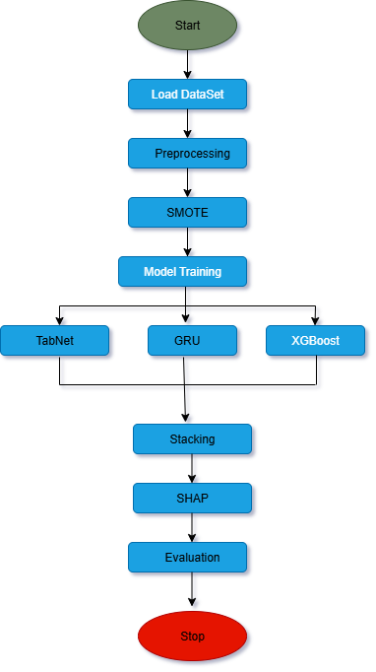
Methodology
Models Used
XGBoost (Gradient boosting)
TabNet (Attention-based deep tabular learning)
GRU (For feature interactions)
Stacked Ensemble
Base models → Logistic Regression meta-learner
Final accuracy: 96%

Slide 11
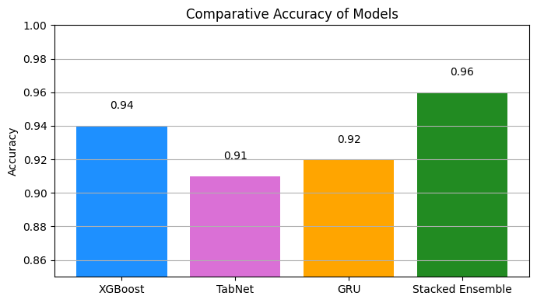
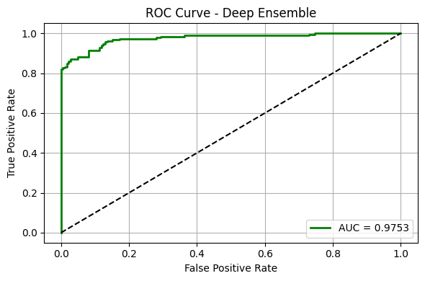
Results and Discussion
Accuracy:
XGBoost 94% ,
GRU 92%,
TabNet 91%,
Stacked Ensemble 96%.
AUC: 0.9753 (excellent discrimination)
Training vs Testing: 100% vs 96% → very low overfitting
SHAP Insights: Burnout Index, Income/Economic Stress, Engagement Score are top predictors
Fairness: Balanced accuracy and AUC across gender & age groups

Slide 12
Conclusions and Future work
Conclusion
Fair-ExplainHR is accurate, interpretable, and fairness-aware.
Human-centric features improve prediction quality.
SHAP enhances transparency for HR decision-making.
Future Work
Integration into live HRIS systems for real-time monitoring.
External validation on multi-industry datasets.
Reduce computation cost for large-scale deployment.
Explore transformer-based explainable models

Slide 13
References
[1]. A.Ahmad, A. Khan, and S. Patel. Machine learning based predictive model for employee attrition. International Journal of Human Resource Analytics, 12(2):101 110, 2025.
[2]. G. Kaur and S. Verma. Feature importance and ensemble techniques for attrition risk modelling. Journal of Ap plied Machine Learning for Business, 9(1):73–82, 2025.
[3]. P. Krishna and R. Sidharth. Comparative analysis of classifiers for employee attrition prediction. Procedia Computer Science, 203:244–251, 2025.
[4]. V. Sharma and A. Nayyar. Fuzzy-inspired hybrid system for hr turnover forecasting. Journal of Intelligent Decision Support Systems, 18(1):45–56, 2025.
[5]. A. Verma, P. Bhavsar, and R. Patel. Comparative study of classification algorithms for employee attrition pre diction. In IEEE International Conference on Inventive Systems and Control, pages 112–117, 2020.

Slide 14


